Slide 2


Unit
5
NATURAL WONDERS OF VIET NAM
LESSON 2: A CLOSER LOOK 1
1

Slide 3
LESSON 2: A CLOSER LOOK 1
LESSON 1: GETTING STARTED
WARM-UP
Brainstorming
Task 1: Write a word under each picture.
Task 2: Complete the sentences.
Task 3: Put the items in order of usefulness.
VOCABUALRY
PRONUNCIATION
Task 4: Listen and repeat.
Task 5: Listen and repeat.
EXTRA ACTIVITY
Game: Whispering
CONSOLIDATION
Wrap-up
Homework

Slide 4

WARM-UP

Slide 5

Work in two teams
Run to the board and write down as many travel items as possible (Travel items: Things you bring along when traveling.)
You will have 2 minutes to write
Which team have more correct answers will be the winner.

Slide 6

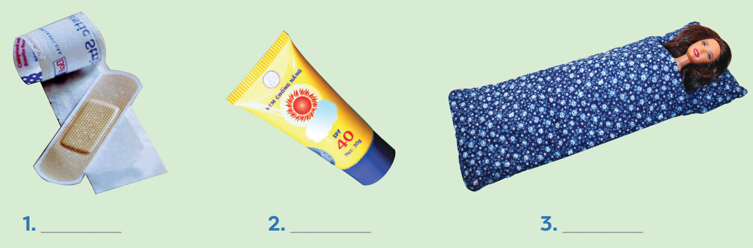
VOCABULARY
Write a word under each picture. Practise saying the words.
plaster
suncream
sleeping bag

Slide 7

VOCABULARY
Write a word under each picture. Practise saying the words.
scissors
backpack
compass

Slide 8
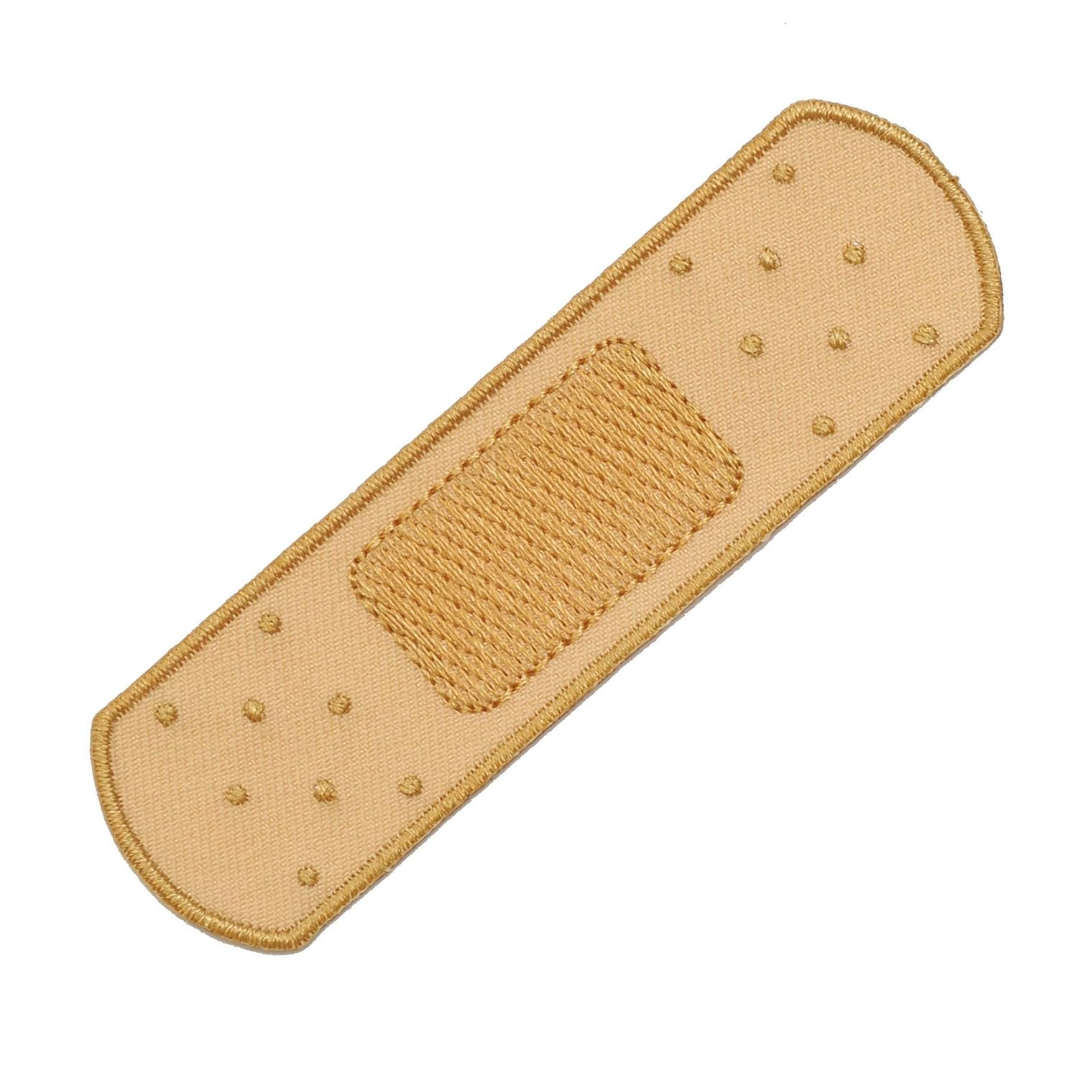

VOCABULARY
plaster (n)
/ˈplɑːstər/
băng, gạc y tế

Slide 9
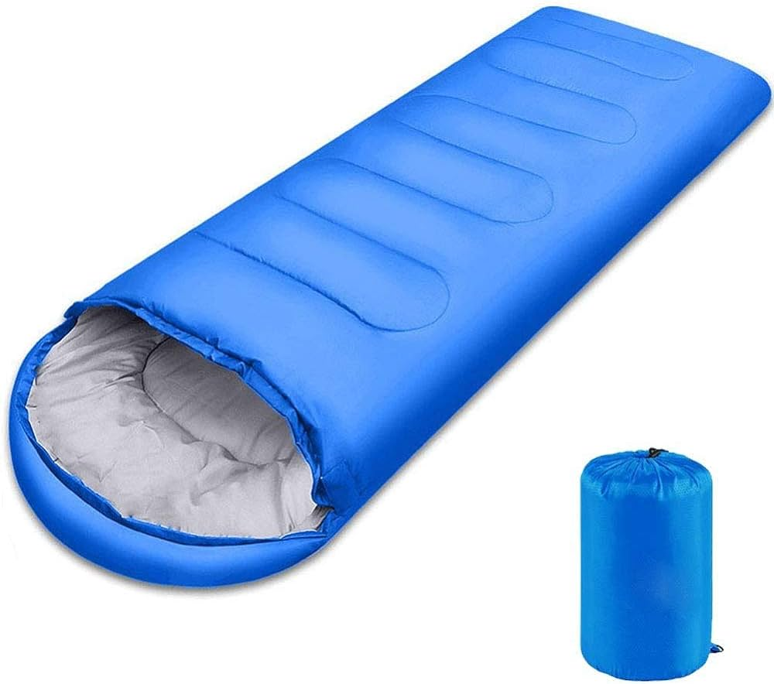
VOCABULARY
sleeping bag (n)
/ˈsliːpɪŋ bæɡ/
túi ngủ

Slide 10
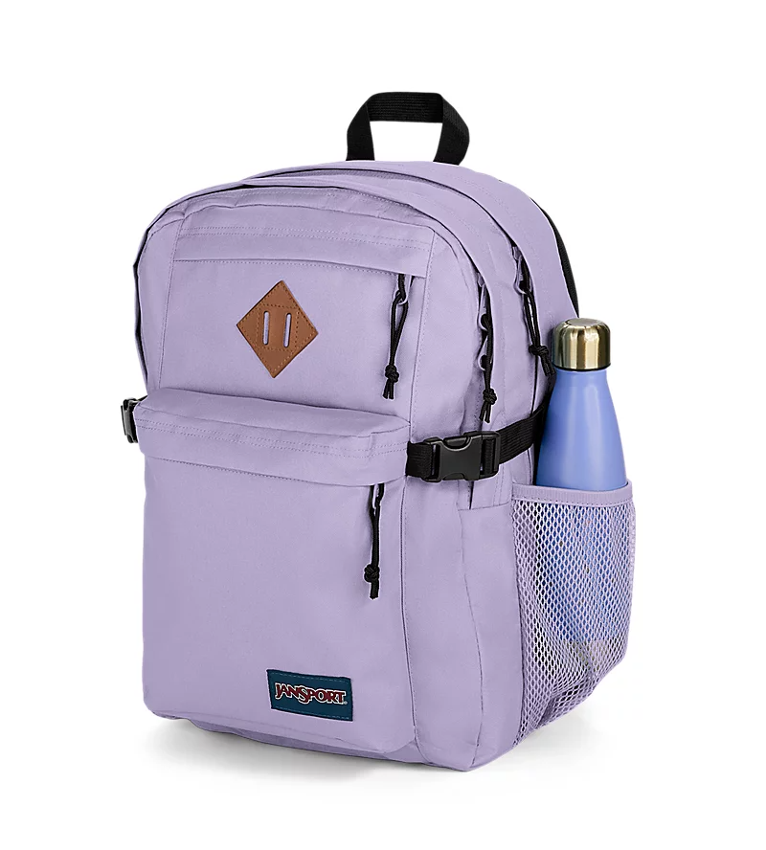
VOCABULARY
backpack (n)
/ˈbækpæk/
ba lô

Slide 11

VOCABULARY
compass (n)
/ˈkʌmpəs/
la bàn

Slide 12
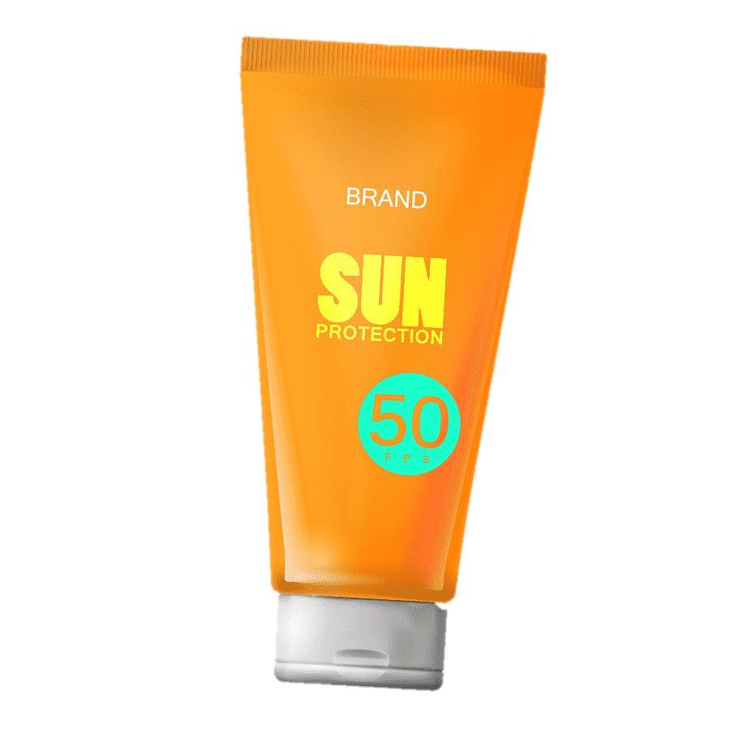
VOCABULARY
suncream (n)
/ˈsʌn kriːm/
kem chống nắng

Slide 13
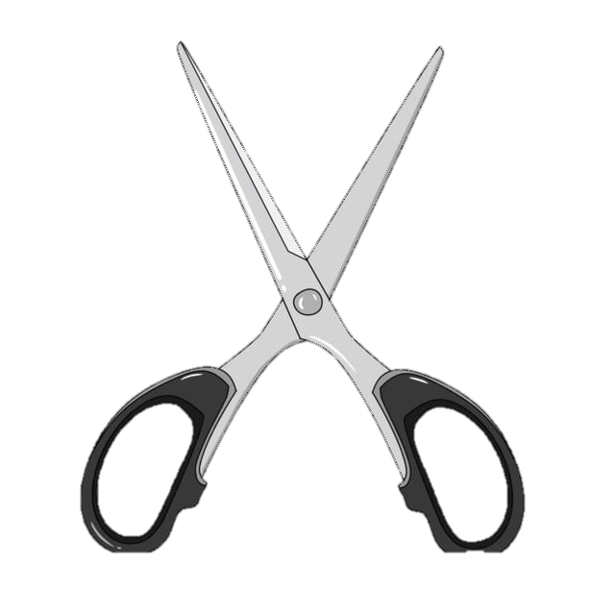
VOCABULARY
scissors (n)
/ˈsɪzəz/
cái kéo

Slide 14

VOCABULARY
Complete the following sentences. Use the words in 1.
1. We’re lost. Please give me the _________.
2. It’s so sunny today. I need to put on some _________.
3. A ____________ is very useful when you go camping overnight.
4. I’ve finished packing. All my things are in my ___________.
5. My foot hurts. I need to put a ________ on my foot.
compass
suncream
sleeping bag
backpack
plaster

Slide 15

VOCABULARY
Now put the items in order of usefulness. Number 1 is the most useful, number 6 is the least useful on holiday.
plaster
scissors
backpack
compass
suncream
sleeping bag
1.
2.
3.
4.
5.
6.

Slide 16

PRONUNCIATION
Listen and repeat the words.
/t/ | /d/
mountain waterfall desert plaster | wonder island guide holiday

Slide 17

PRONUNCIATION
Listen and repeat. Pay attention to the bold-typed parts of the words.
1.
- Where’s my hat?
- Oh, it’s on your head.
2. Where do they stay on their holiday?
3. I need some meat for my cat.
4. The Sahara is a very hot desert.
5. I want to explore the island by boat.

Slide 18
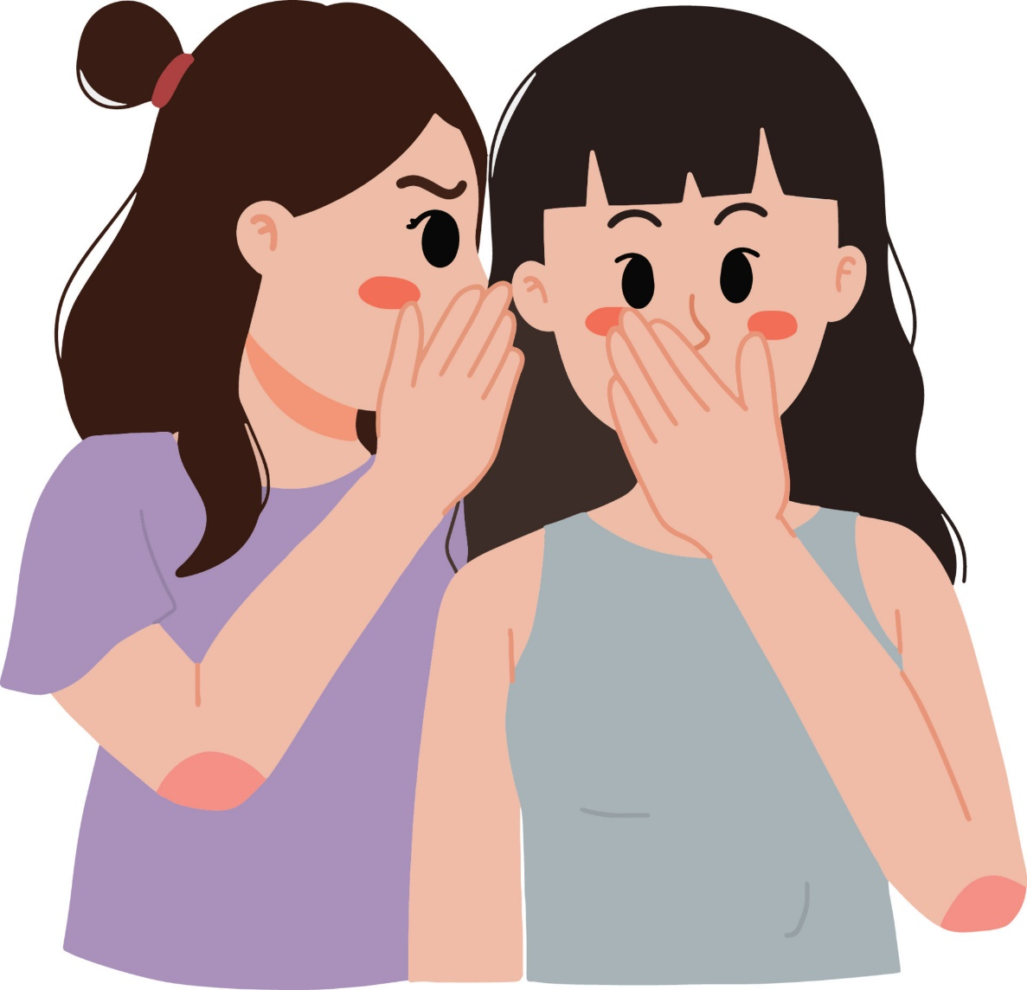
EXTRA ACTIVITY
Whispering

Slide 19

CONSOLIDATION
1
Wrap-up
What have we learnt in this lesson?
Vocabulary: The lexical items related to Travel items
Pronunciation: How to correctly pronounce words that contain the sounds: /t/ and /d/

Slide 20

CONSOLIDATION
2
Homework
- Do exercises in the workbook.
- Find 5 more words with the sound /t/ and 5 more words with the sound /d/. Write them down and practise pronouncing the words.

Slide 21






Website: hoclieu.vn
Fanpage: facebook.com/www.tienganhglobalsuccess.vn/

